Slide 1
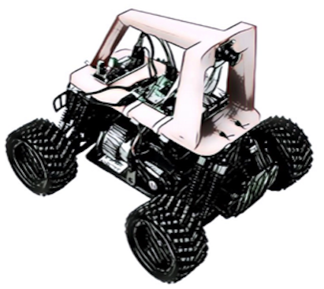
AI Racing League
Welcome for June 2021
Dan McCreary - AI Research Dan.McCreary@gmail.com
On “track” to learn AI

Slide 2
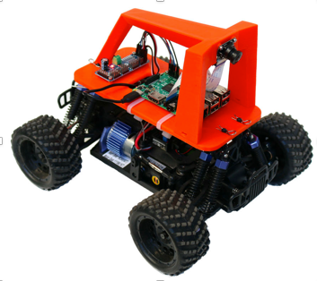
What is the AI Racing League?
The funnest way to teach AI to kids!
Built around around the ”DonkeyCar”
RC car chassis
Camera
Raspberry Pi
Open software built Python
3D printed roll cage ($50)
Camera ($25)
Raspberry Pi 4 ($60)
RC Car Chassis
($100-$200)
Total Cost: $250 to $400

Slide 3

Why “Donkey Car”
They are not designed to be “fast” looking
They are safe for kids
They occasionally don't follow their drivers commands
The ugly connotation so expectations are super low

Slide 4
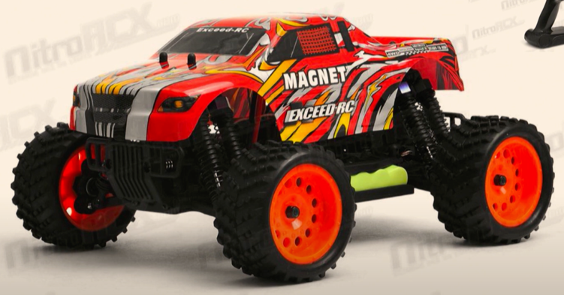
$100 RC Car

Slide 5
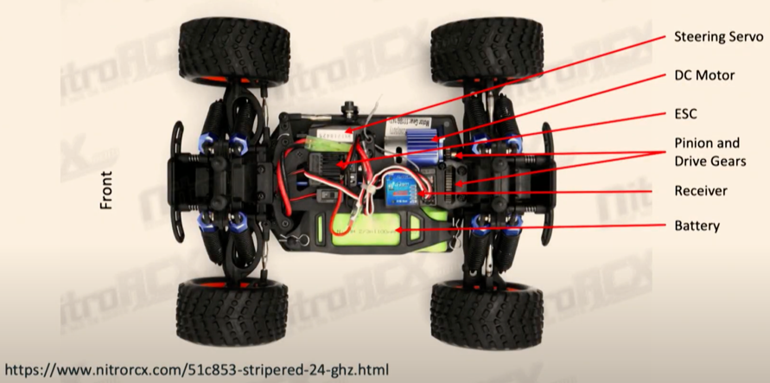
Key Parts of an RC Car

Slide 6
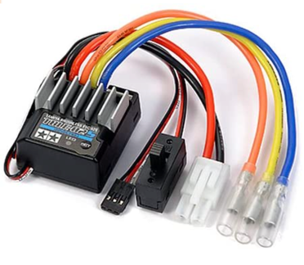
Electronic Speed Controller
Sends the right amount of battery power to the motor based on the input from a computer
Can make the motor turn forward and backwards
From
Battery
From Computer
To Motor

Slide 7
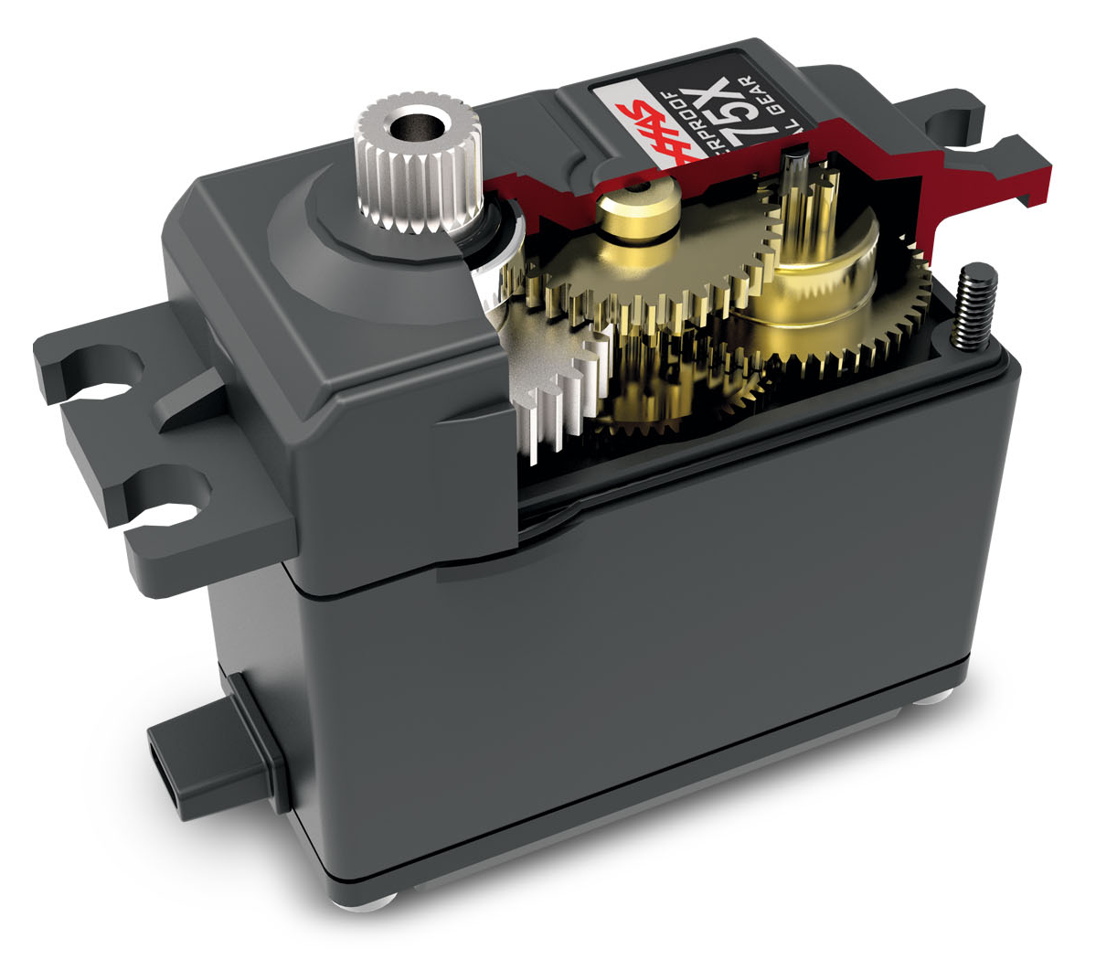
Servo Motor
Used to steer the car
Only turns 180 degrees

Slide 8
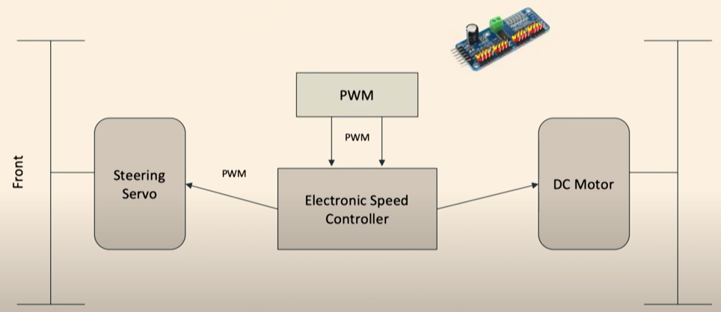
How Parts Connect

Slide 9
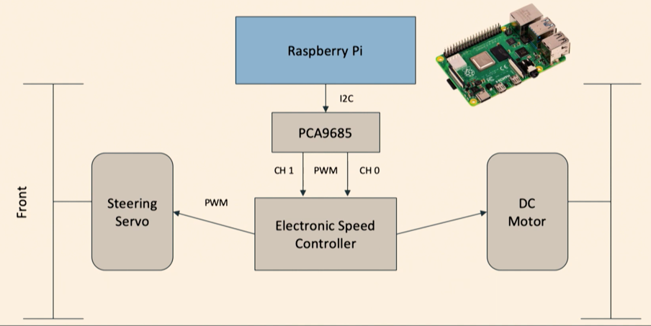
Raspberry Pi

Slide 10
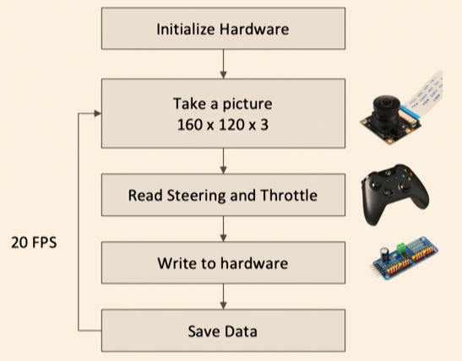
Get Training Data

Slide 11
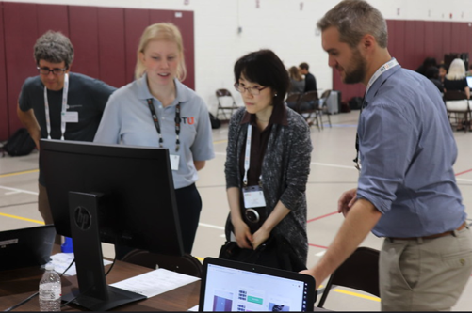

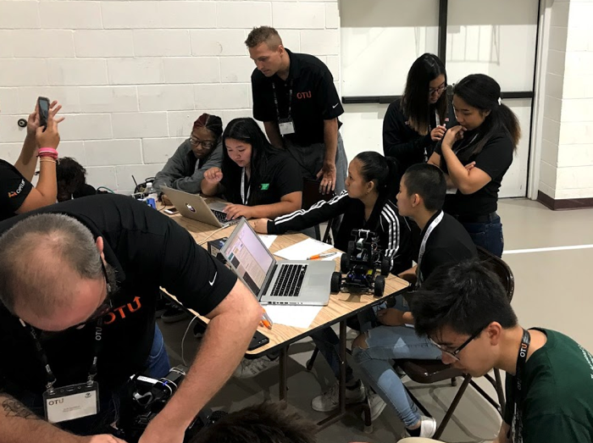
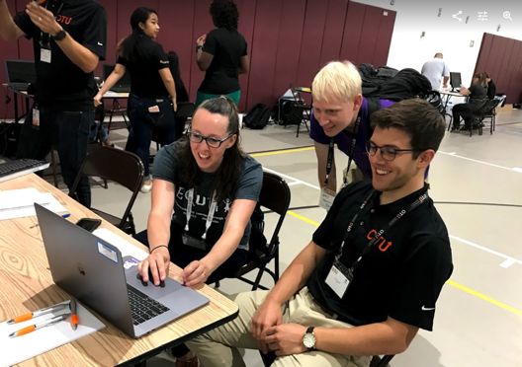
AI Racing League Launch Event, August 6, 2019
65 registrants 23 Optum mentors
34 attendees 22 external attendees
(65% of participants)
Notes:
Photo by Mimi Thian on Unsplash
Photo by tribesh kayastha on Unsplash
Photo by Perry Grone on Unsplash

Slide 12
AI Racing League Vision, Alignment and Reach
The AI Racing League is a platform for AI education initiated out of the OTU and Optum Tech Social Responsibility programs, envisioned for use by many businesses, with multiple stakeholders, mentors, participants and sponsors, reaching internal and external constituents.
“Let’s judge ourselves not on how we look in meetings. Let’s judge ourselves by the substance of impact we have on people’s lives.”
Andrew Witty, a CEO Conversation

Slide 13
Our Core Values
Accessibility and Inclusivity: Participation by non-programmers and non-integrated UHG entities
Hands on/High touch: Direct participation by senior AI researchers and developers with product managers
Agile Adaptive Learning: No fixed forced curriculum – we adapt to the needs of each student
Open Source and Open Content: All training materials can be reused by clubs around the world for non-commercial use (with attribution)

Slide 14
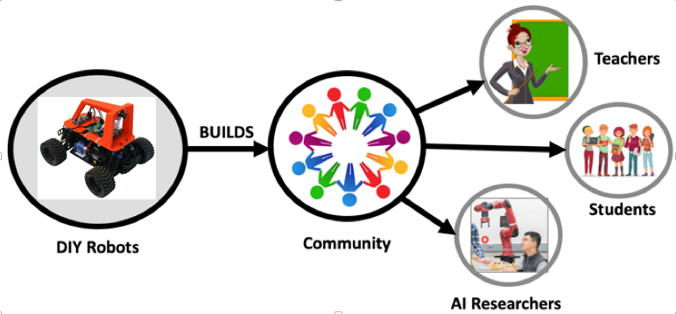
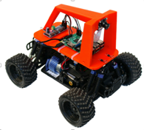
The AI Racing League is a Community
A community promoting fun ways to learn AI
A way to get students involve in STEM using a fun robot activity
A curriculum based around the popular “DonkeyCar” design
A way to build a community
Teachers
CoderDojo Mentors
Students
AI Researchers (Optum)
International
Twin Cities

Slide 15
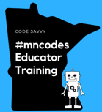

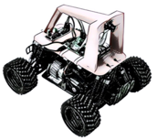

About Code Savvy
https://codesavvy.org
Special Events
MN State Fair
Hackathons
LED Costume Contests
AI Racing League
Code Clubs
Code Camps
Mentor Training
Virtual Learning
STEM Curriculum
Corporate Programs
Twin Cities
Rebecca CoderDojo
Regional Clubs
Annual Challenge
Teaching Computer Science
Teacher Education
@mncodes

Slide 16
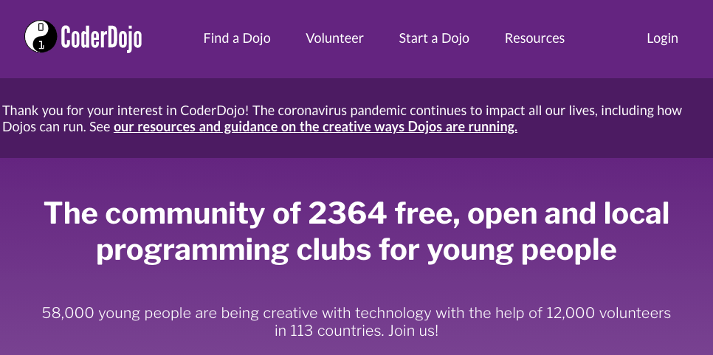
About CoderDojo
Now part of the Raspberry Pi Foundation
2,300+ Coding Clubs around the world
Evidence-driven curriculum design
Mentoring based strategy

Slide 17
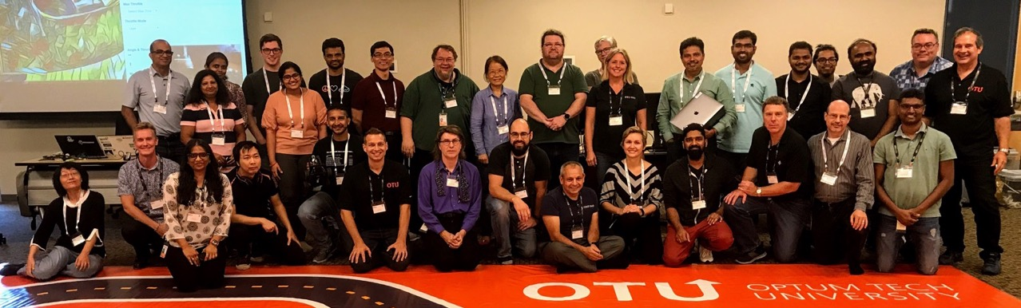
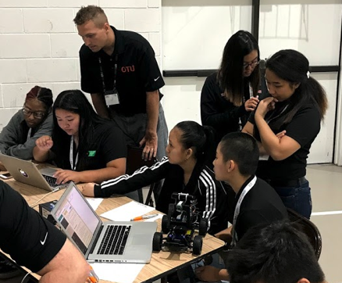
Mentor Training is the Key!

Slide 18
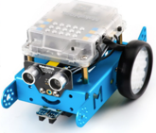
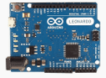
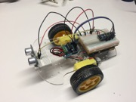


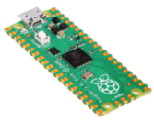
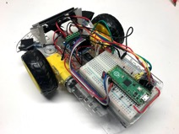
AI Racing League Learning Paths
Arduino Uno (C)
$25 Arduino Robot (C)
mbot
(scratch)
?
200x
Web
Mobile Apps
Unity
AI Racing League
$4 Micropython
Raspberry Pi Pico
Pico Robot
MicroPython
Student driven “Agile” mentoring / rhizomatic learning / concept cards

Slide 19
The AI Racing League Methodology
3D printed roll cage ($50)
“High touch” hands-on learning for single-day events
Mentors work directly with students
Background checks (free) for all students
No more than three students per mentor
No fees – leverage STEM grants
Concept cards are used to decompose complex learning into components
Easy to integrate into local CoderDojo programs
All content is licensed for noncommercial reuse
Focus on low-cost but fun events!
Camera ($25)
Raspberry Pi 4 ($60)
RC Car Chassis
($100-$200)
Total Cost: $250 to $400

Slide 20
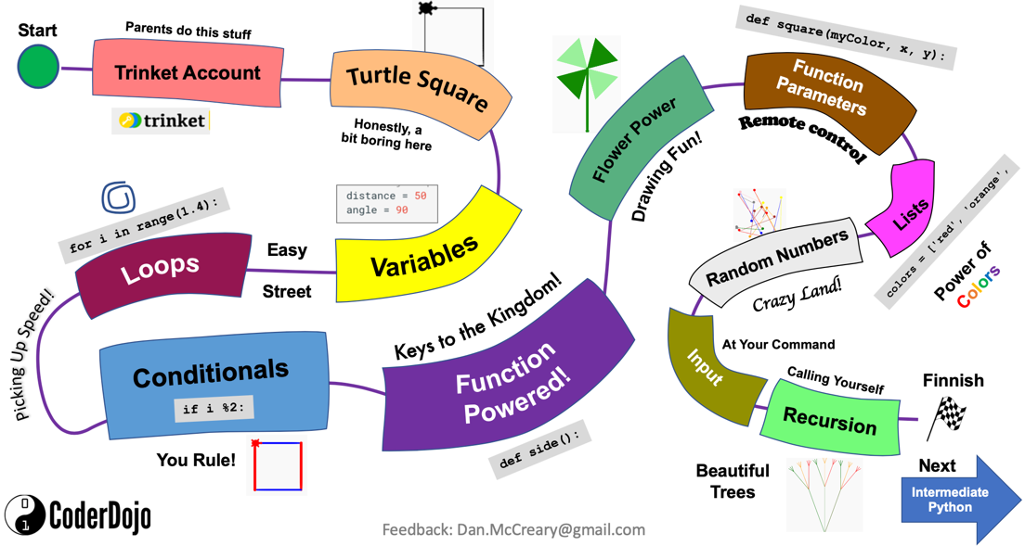
Sample Learning Journey Map

Slide 21


AI Racing League Concept Cards
Motors
Raspberry Pi
Python
Computer Vision
Machine Learning
Intermediate Concepts
Starting Concepts
GPU
TensorFlow
Finish!
UNIX
One double-sided laminated card per concept. Activities and suggested questions on the front. Answers on the back.
Starting Concepts (green borders) have no dependencies on other concepts. They should be attempted first.
Intermediate Concepts (blue borders) should be for students that have completed most of the starting concepts or are already familiar with the topic.
Finishing Concepts (black borders) should be attempted after the intermediate concepts are mastered.
Training a Model
Finishing Concepts
Notes:
At CoderDojo these are called “Sushi Cards” - they are single bit concepts.
http://kata.coderdojo.com/wiki/Category:Sushi_Card
For inspiration check out these cards: https://www.teacherspayteachers.com/Browse/Search:concept%20cards
https://www.teacherspayteachers.com/Browse/Search:concept%20cards%20robotics
See also: https://projects.raspberrypi.org/en/projects/build-a-buggy

Slide 22
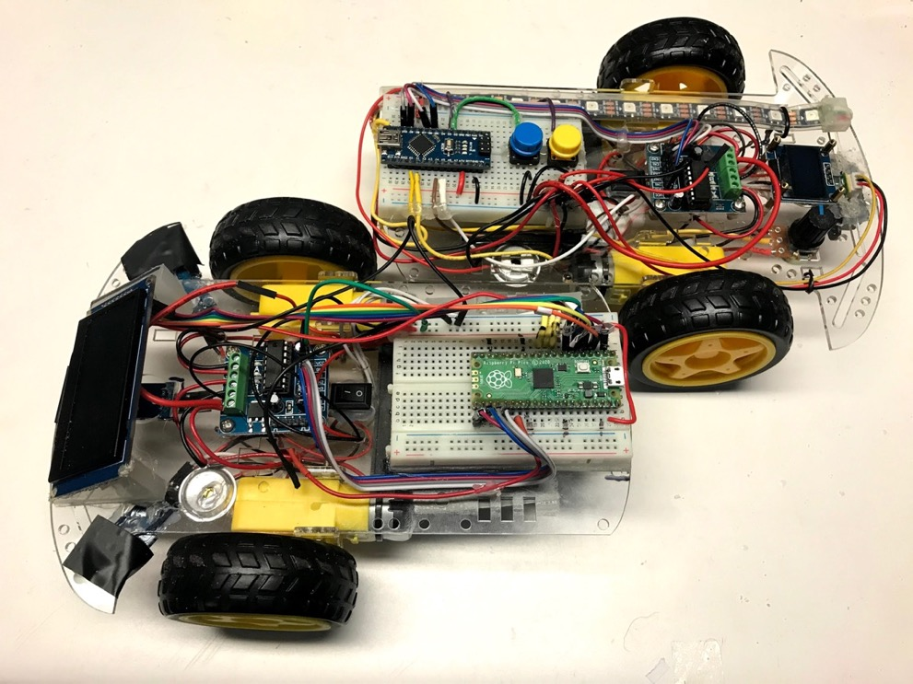
Sustainable Robotics
Design robots to make it easy to upgrade your robot
Easy to upgrade your:
Processor
Sensors
Battery
Software
Teachers have the “right to repair”

Slide 23
Where We Need Help
Mentor recruitment
We have 10x more students than we have mentor volunteers
Recruiting more women and minority mentors
Communication and awareness building

Slide 24
Thank You!
AI Racing League Internal OTU Site:
https://github.optum.com/pages/OptumTechUniversity/otu-ai-racing-league
AI Racing League Public Site: https://coderdojotc.org/ai-racing-league
Mentor Resources: http://coderdojotc.org/CoderDojoTC

